Slide 1

Revision
Security

Slide 2
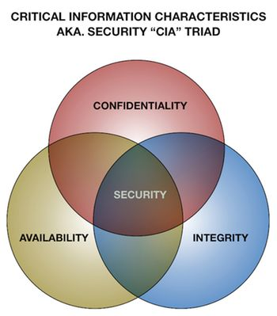
Information security
The computer Triad-- CIA
Confidentiality
Integrity
Availability
Security measure to ensure that data is confidential, has integrity and moreover available
Security measures such as
Authentication methods
Authorization methods
Backup in case data becomes unavailable

Slide 3
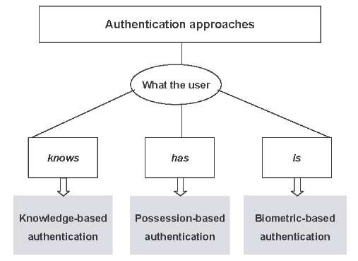
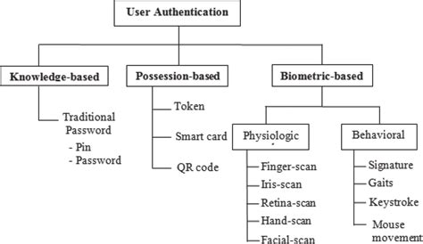
Authentication

Slide 4
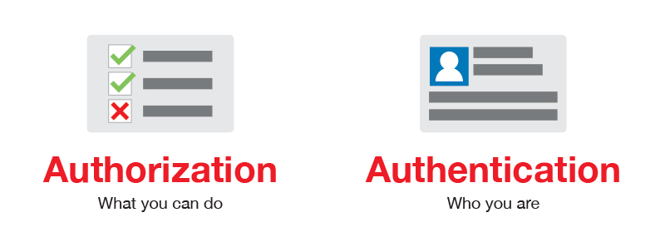
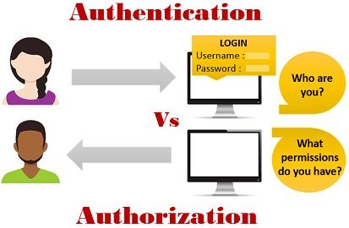
Authorization
Types of Authorization
Access control
Audit trail
Intrusion Detection software
firewall
Proxy Servers

Slide 5
Authentication Vs Authorization
Authentication | Authorization
Authentication confirms your identity | Authorization determines whether you are authorized to access the resources.
It is the process of validating user credentials to gain user access. | It is the process of verifying whether access is allowed or not.
It determines whether user is what he claims to be. | It determines what user can and cannot access.
Authentication usually requires a username and a password. | Authentication factors required for authorization may vary, depending on the security level.
Authentication is the first step of authorization so always comes first. | Authorization is done after successful authentication.

Slide 6
Availability (Recovering from data loss)
In addition to problems arising from malicious activity there are a variety of reasons for accidental loss of data.
A disk or tape gets corrupted
A disk or tape is destroyed
The system crashes
The file is erased or overwritten by mistake
The location of the file is forgotten.
Types of backup
Regular backup
Fault tolerance
Disk Mirroring (RAID)
Archiving

Slide 7
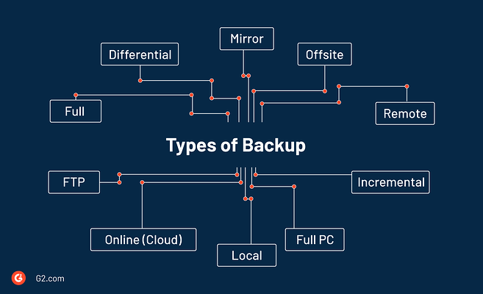
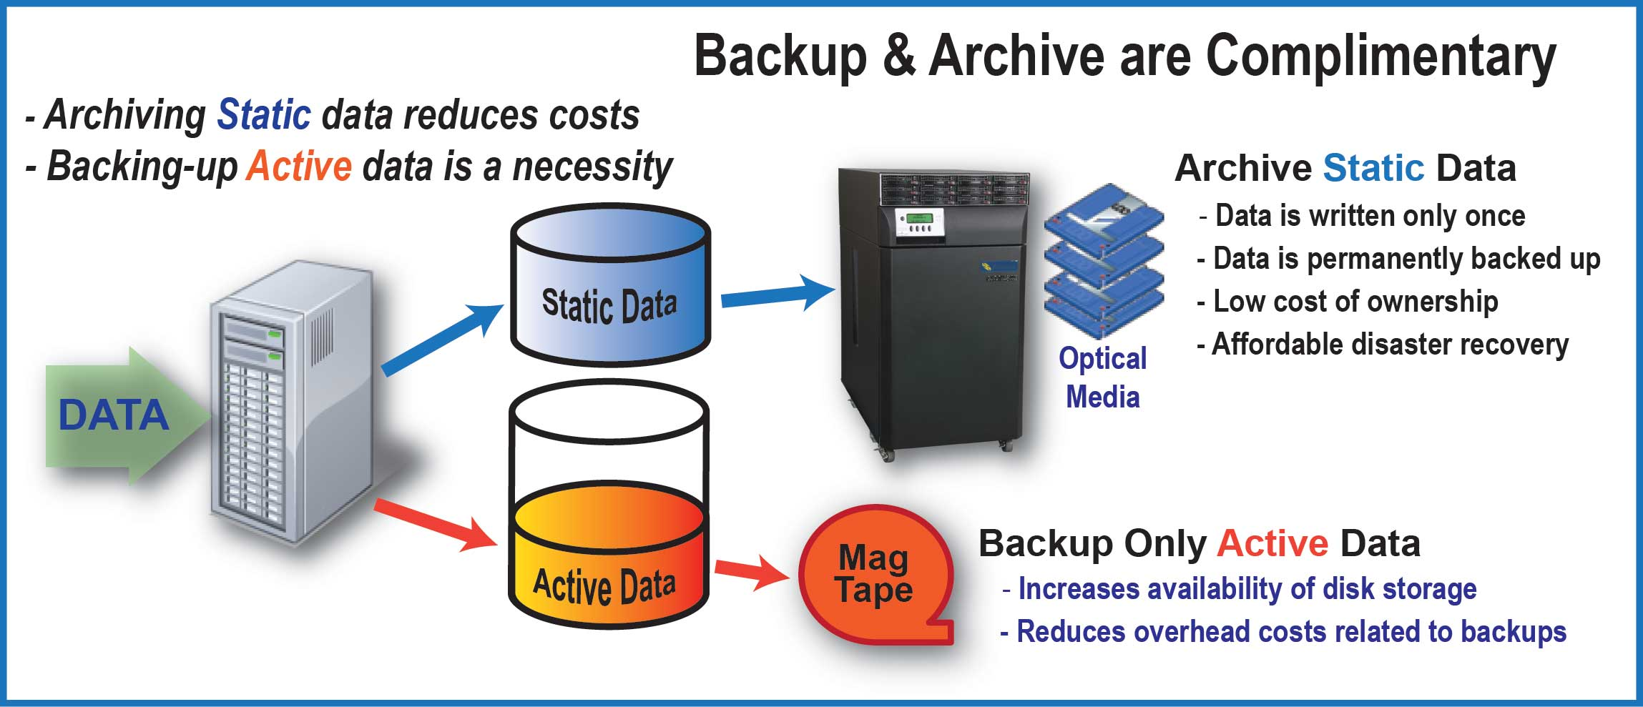
Data backup

Slide 8
Data Validation and Verification

Slide 9
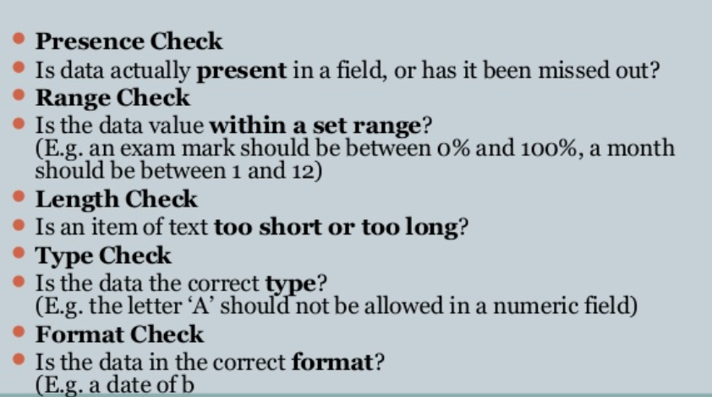
Data Validation

Slide 10
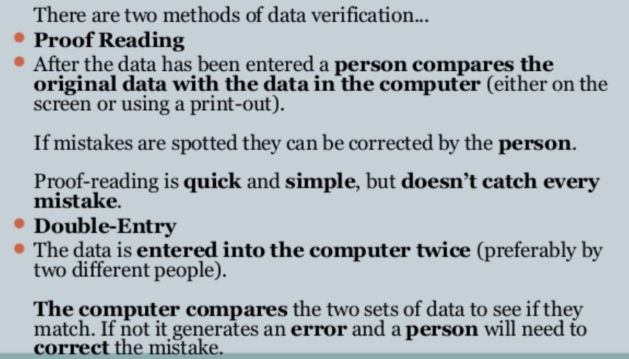
Data Verification

Slide 11
Encryption
What is encryption?
Process of converting readable data into unreadable characters to prevent unauthorized access
Uses
For protection of data transmitted over a network from unauthorized manipulation and viewing.
To protect information on a computer hard drive from viewing and alteration by unauthorized personnel
To verify whether a document is authentic

Slide 12
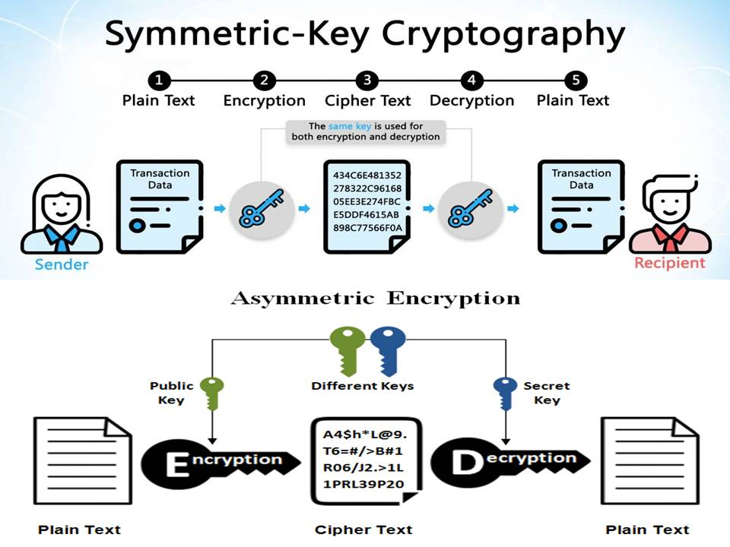
Types of Encryption

Slide 13
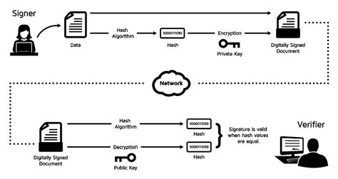
Digital Signatures
An encrypted code that a person, Web site, or organization attaches to an electronic message to verify the identity of the message sender.
Digital signatures often are used to ensure that an impostor is not participating in an Internet transaction. That is, digital signatures help to prevent e-mail forgery.

Slide 14
Digital Certificate
electronic "password" that allows a person, organization to exchange data securely over the Internet using the public key infrastructure (PKI).
Contents of the Digital Certificate
Subject Name
Information about the person who issue the certificate authority (CA)
Serial number
Validity period
Signature -
Signature algorithm –
Public key information -

Slide 15
Contents of a Digital Certificate
Subject Name
Information about the certificate issuer/certificate authority (CA)
Serial number
Validity period
Signature -
Signature algorithm –
Public key information -
Signature - This is the digital signature of the entire digital certificate, generated using the certificate issuer's private key
Signature algorithm - The cryptographic signature algorithm used to generate the digital signature (e.g. SHA-1 with RSA Encryption)
Public key information - Information about the subject's public key. This includes:
the algorithm (e.g. Elliptic Curve Public Key),
the key size (e.g. 256 bits),
the key usage (e.g. can encrypt, verify, derive), and
the public key itself

